Slide 1
Sales Data Analysis and Prediction

Slide 2
Objectives
Supermarket or grocery store are becoming a go to place to access multiple products.
To generate high profits its is necessary to predict future sales.

Slide 3
Problem statement
The implemented algorithm focuses predicting the sales of products which are located at different outlets which belongs to the Big Mart chain.
Multiple linear regression algorithm predicts the sales of item for that store

Slide 4
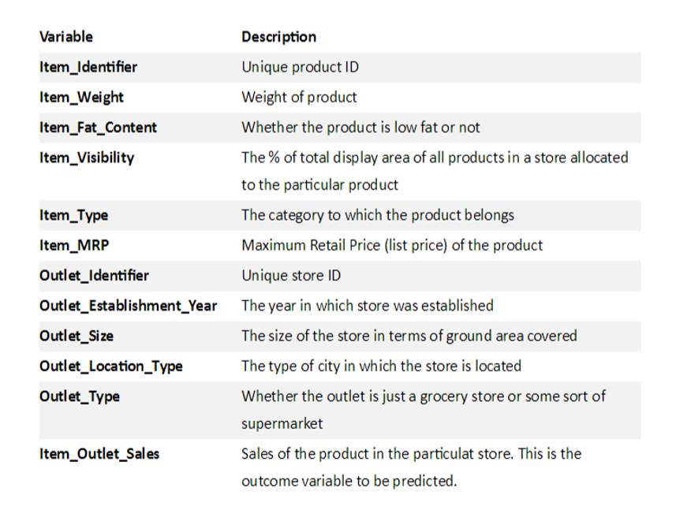
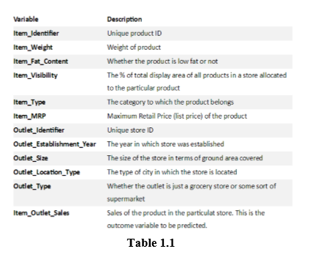

Slide 5
Multivariate Regression
Multiple linear regression or commonly known as Multivariate regression is a popular technique for prediction.
The main idea behind this is to visualize the data as an equation where each variable is assigned a weight.

Slide 6
Preprocessing
Data cleaning
In the Big mart sales data following columns shoes missing values: “Item_Weight”, “Outlet_Size”.
Following steps were taken to get rid of the missing values.
For “Item_Weight” we replace the missing values with mean of the column and for “Outlet_Size” we replace the values with the mode of column.

Slide 7
Feature Engineering
Attribute “Item_Fat_Content” is a categorical attribute which had two categories: Low Fat and Regular.
However, the data had Low Fat, low fat, LF, reg and Regular which were then renamed Low Fat and Regular respectively.
Attribute “Outlet_Establishment_Year” did not had much intuitive meaning and hence it was replaced with how old the store is. This might help us determine better sales because if store is.

Slide 8
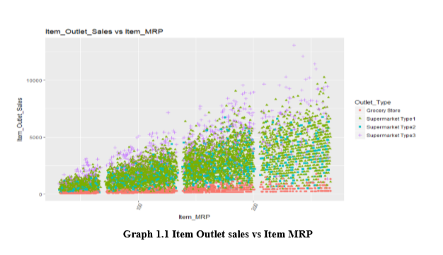
Data Visualization

Slide 9
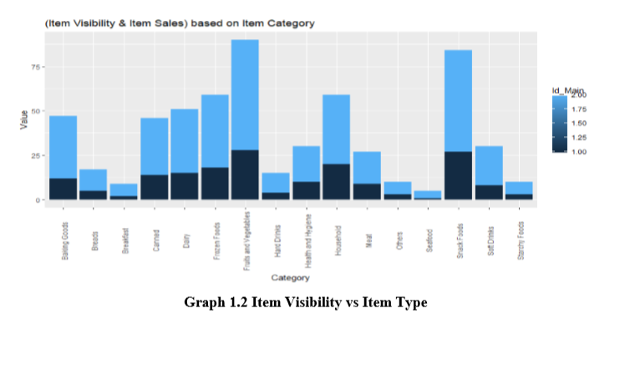

Slide 10
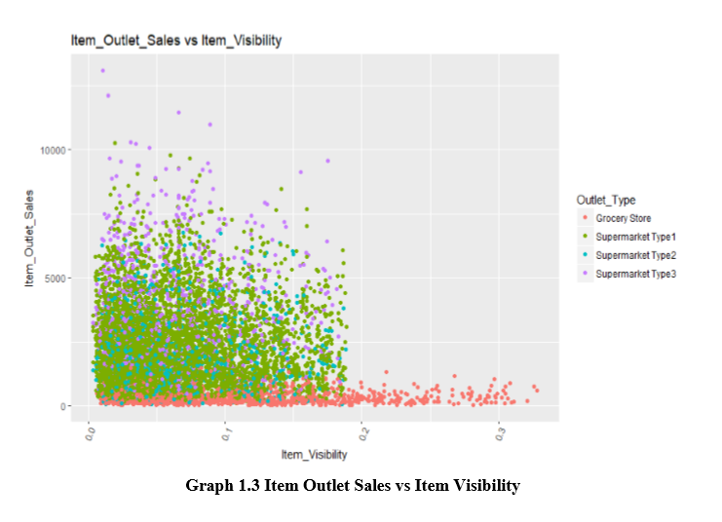

Slide 11
Results
This algorithm was implemented on the Big Mart Sales data and as multivariate regression does not take in to account categorical attribute.

